Slide 1
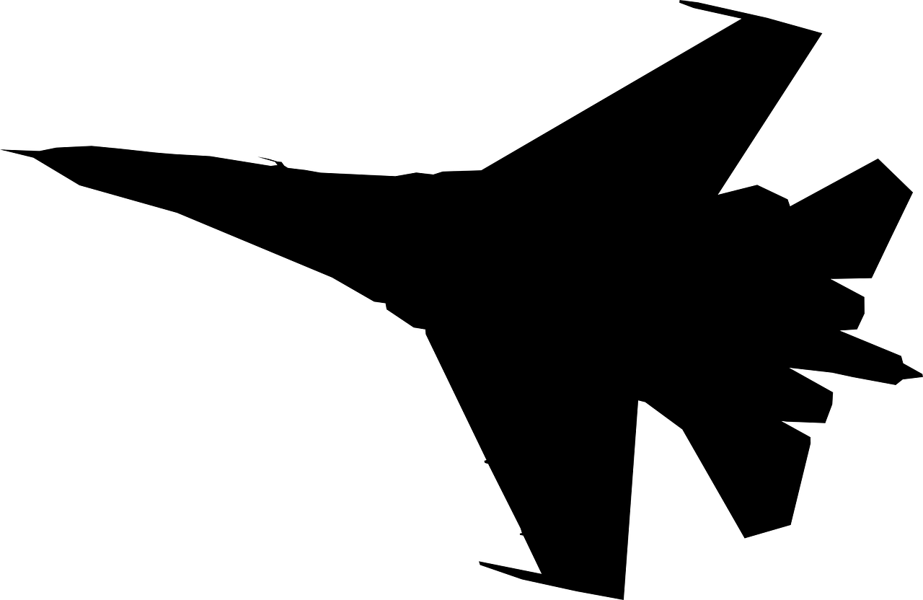
Design of Actuated Systems for Flying Machines
Ryan Oppen
Mentored by Timothy Takahashi

Slide 2
Objectives
Contemporary aircraft incorporate many actuated systems
Must first determine loads acting on the systems
  Steady loads (lift, drag, thrust)
  Unsteady loads (buffeting, cavity resonance, vibrations)
After determining loads, actuated system can be designed

Slide 3
Experimental Setup
Designed an experiment to determine the loads
Experiment took place in a low-speed wind tunnel
Hotwire probe was used to measure instantaneous velocities
Two example shapes: cylindrical rod and rectangular block
Velocity changes in and out of wake were used to determine the steady and unsteady loads

Slide 4
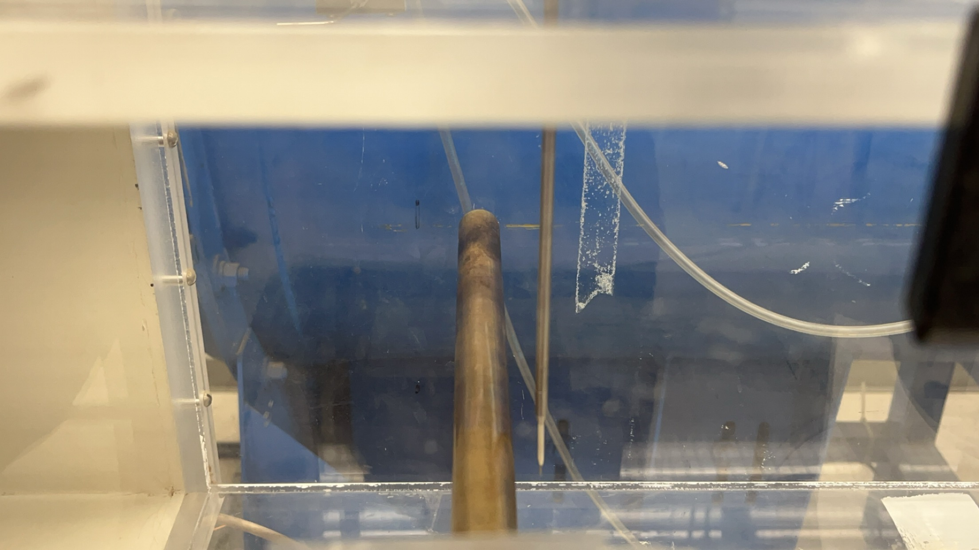
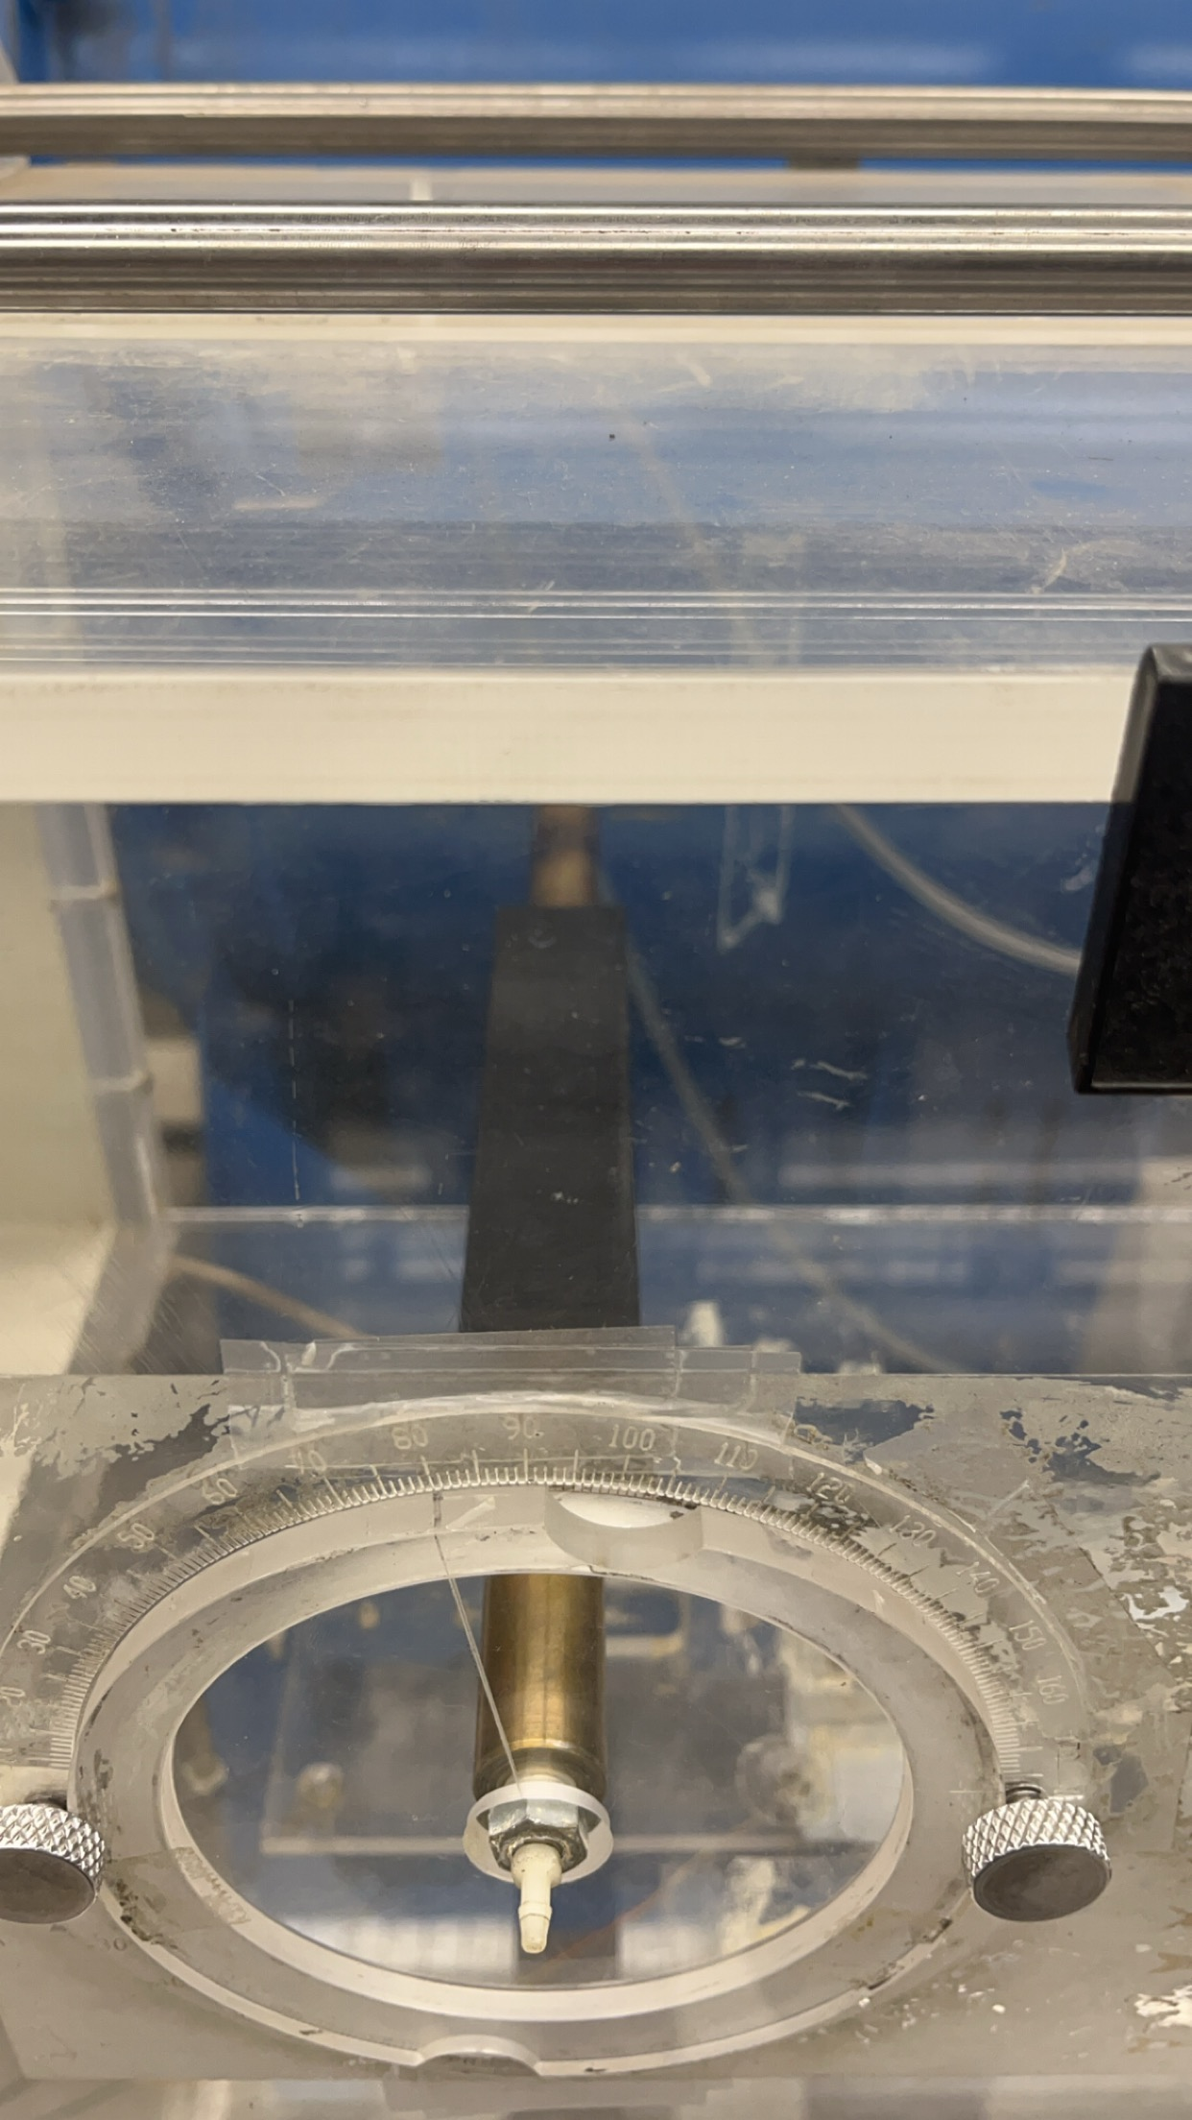
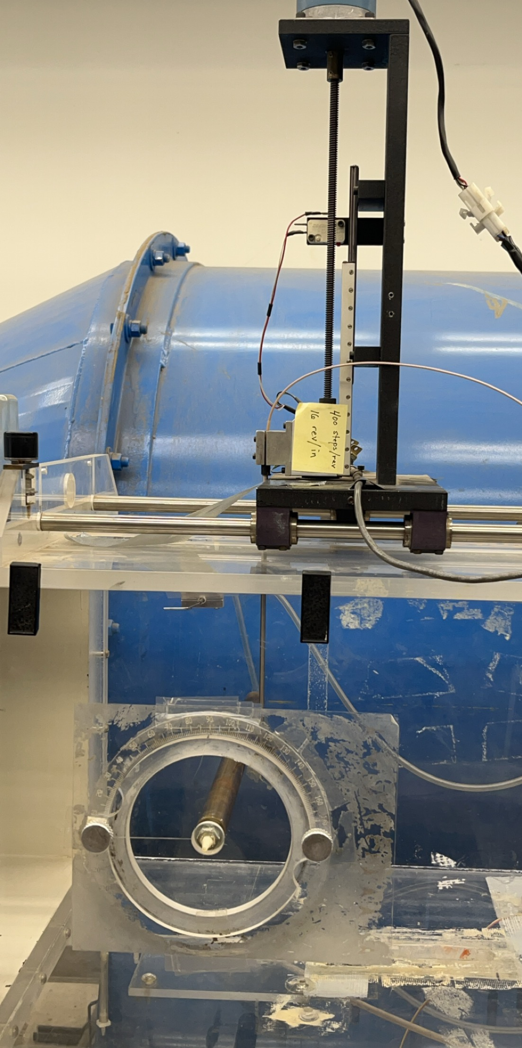
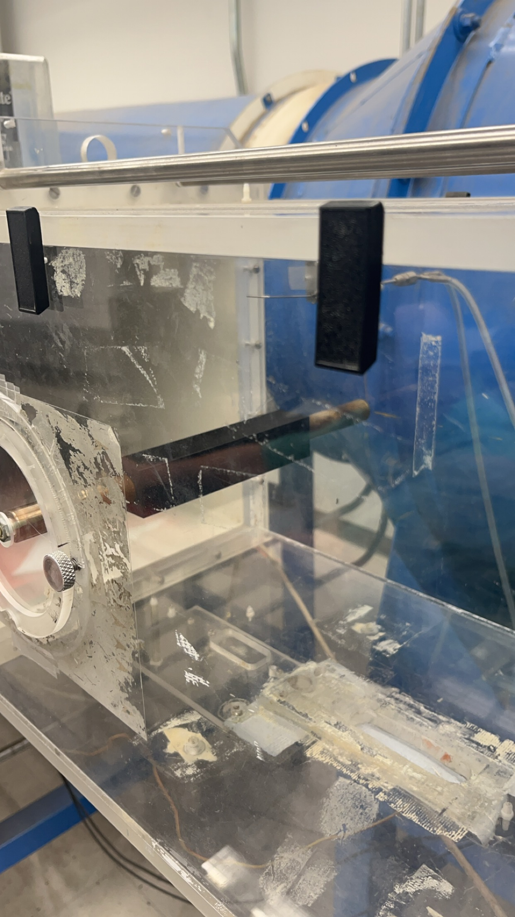
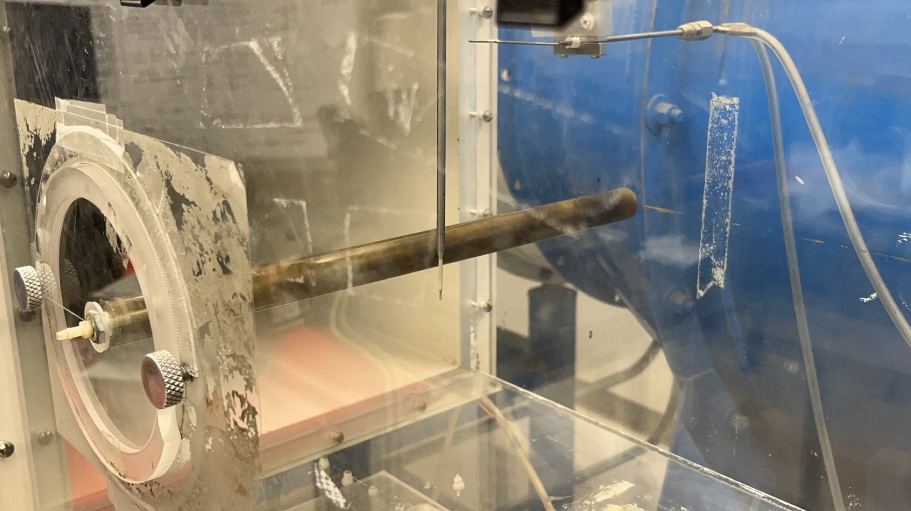
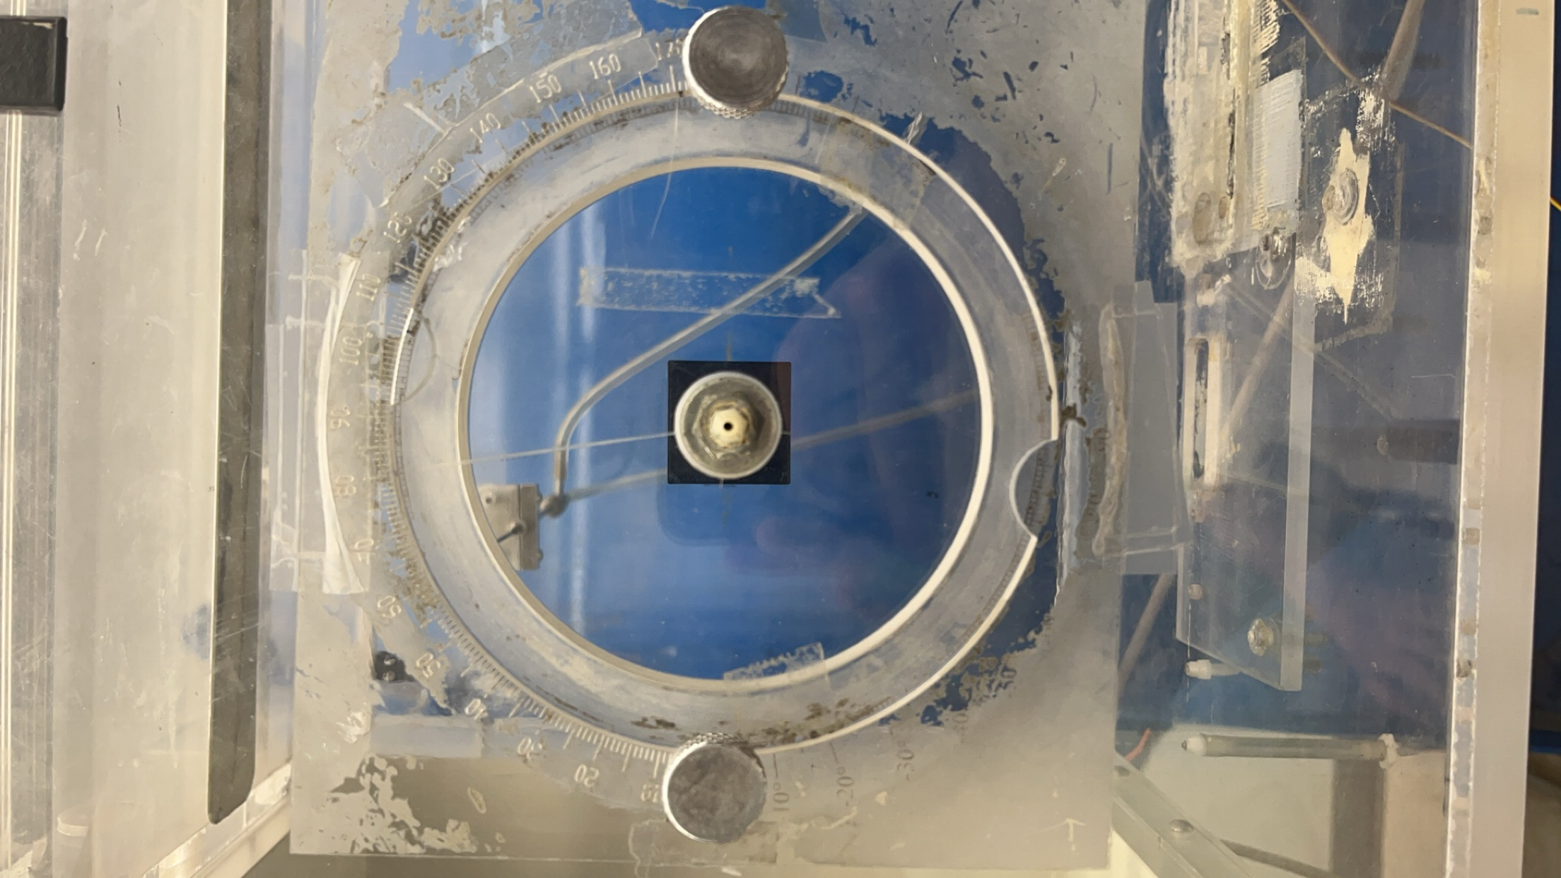
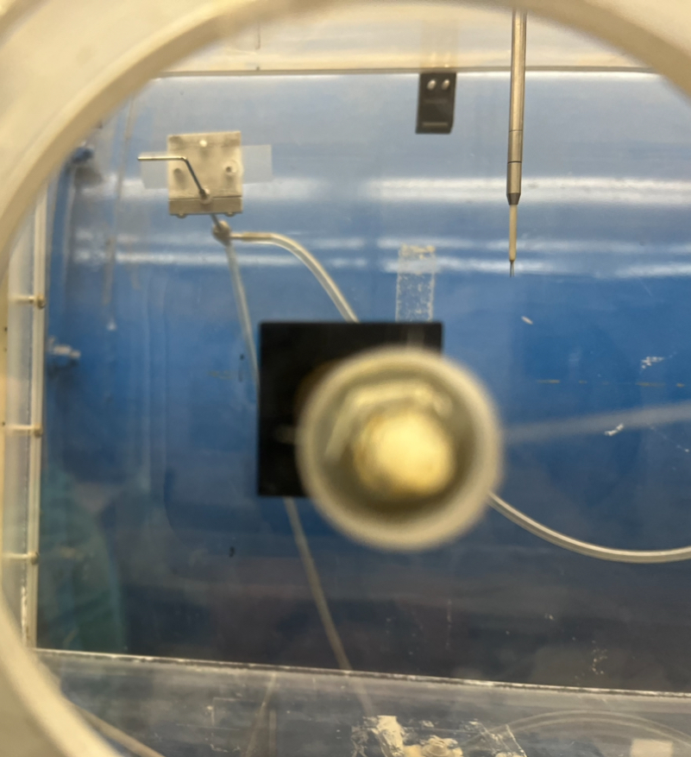

Slide 5
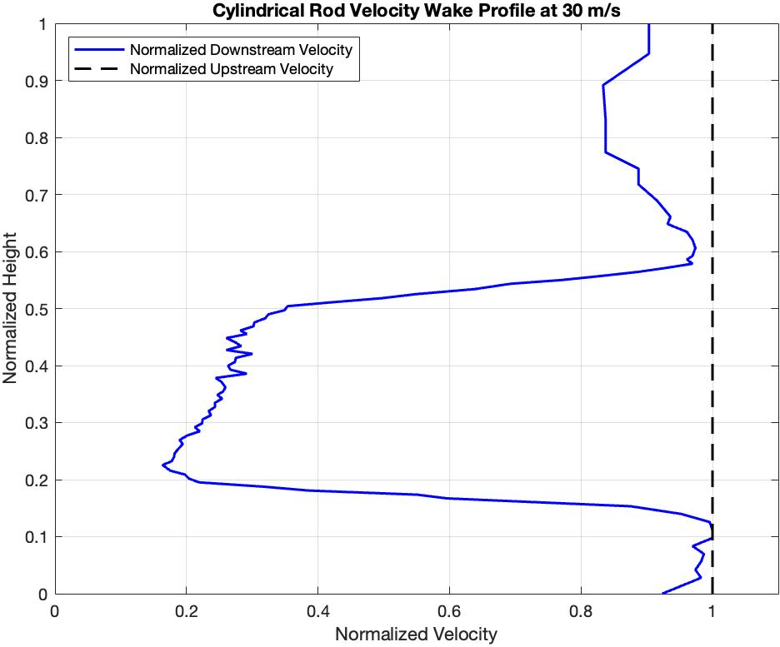
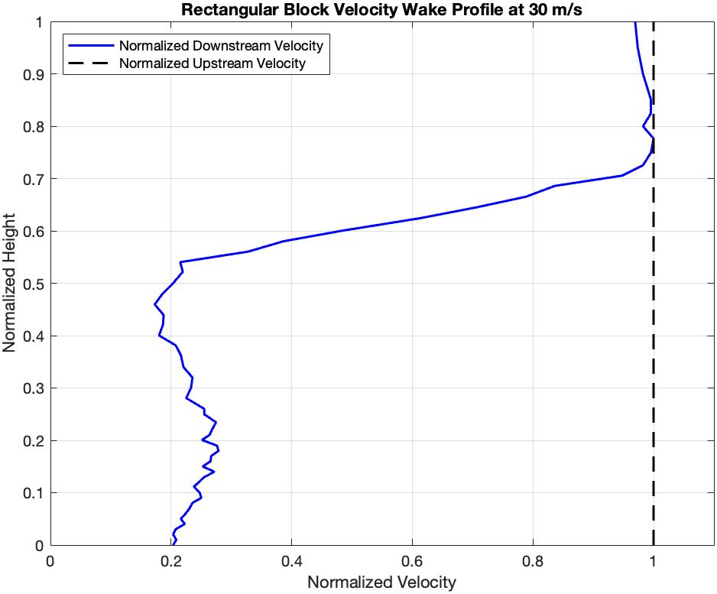
Visual Results – Velocity Wake Profiles

Slide 6
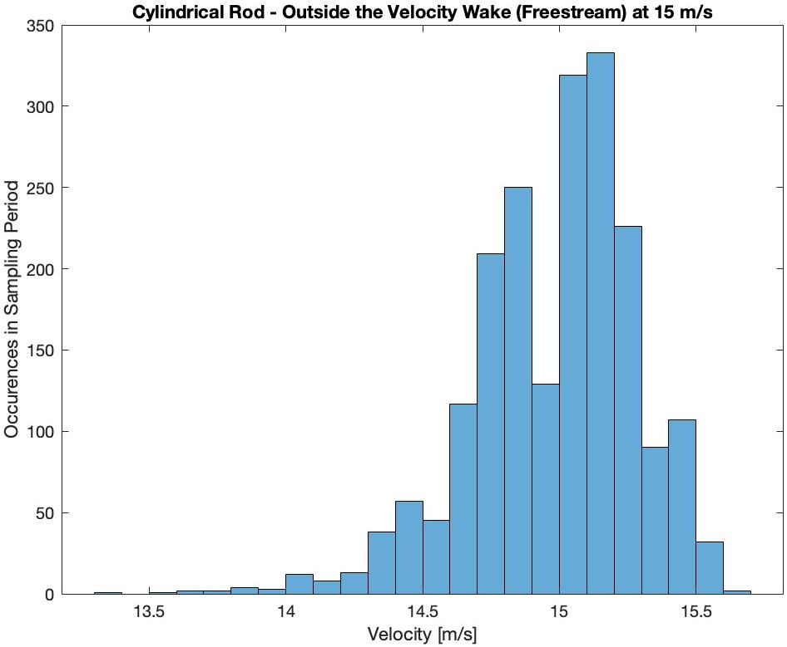
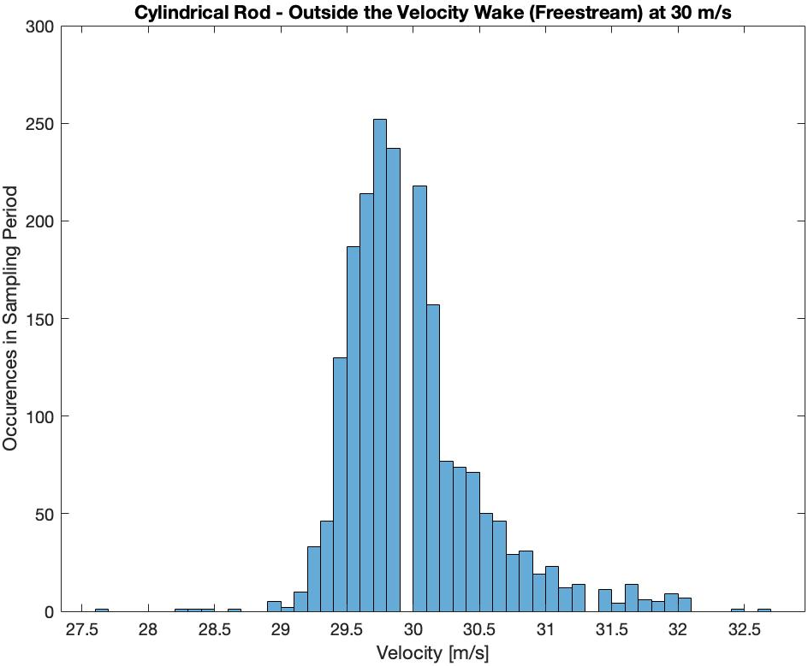
Visual Results – Cylindrical Rod (Freestream)

Slide 7
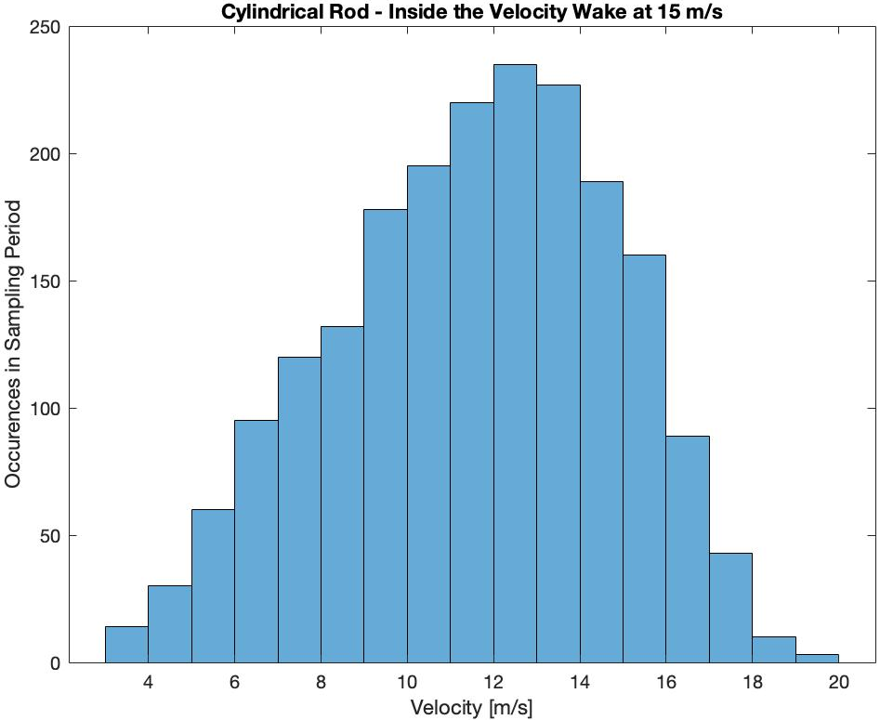
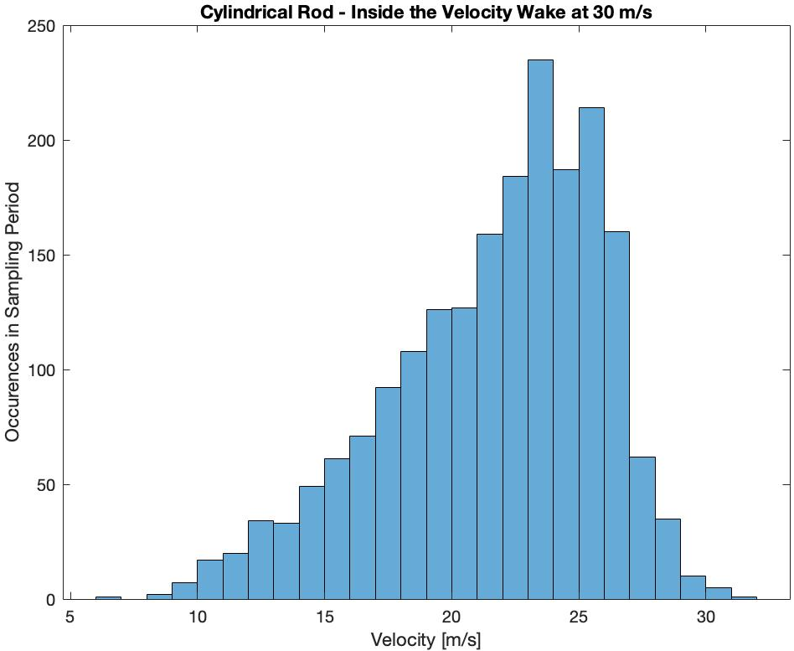
Visual Results – Cylindrical Rod (Inside the Wake)

Slide 8
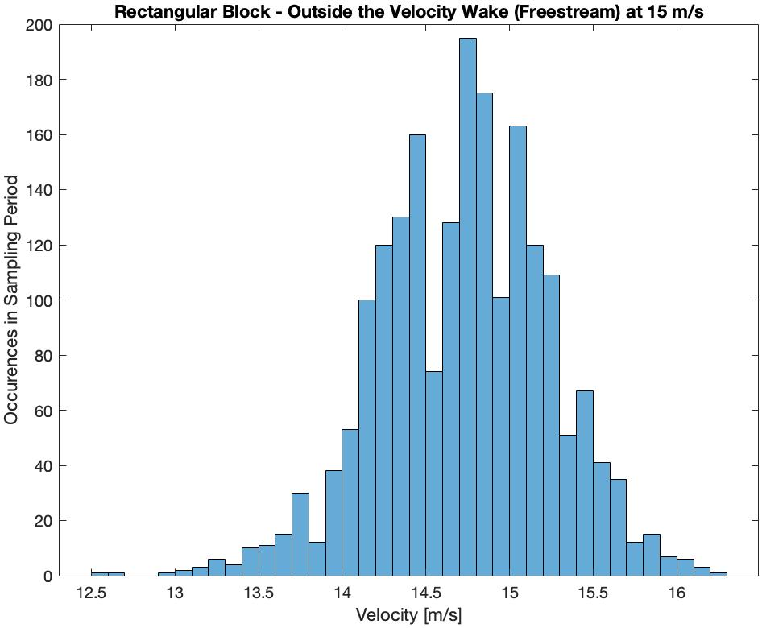
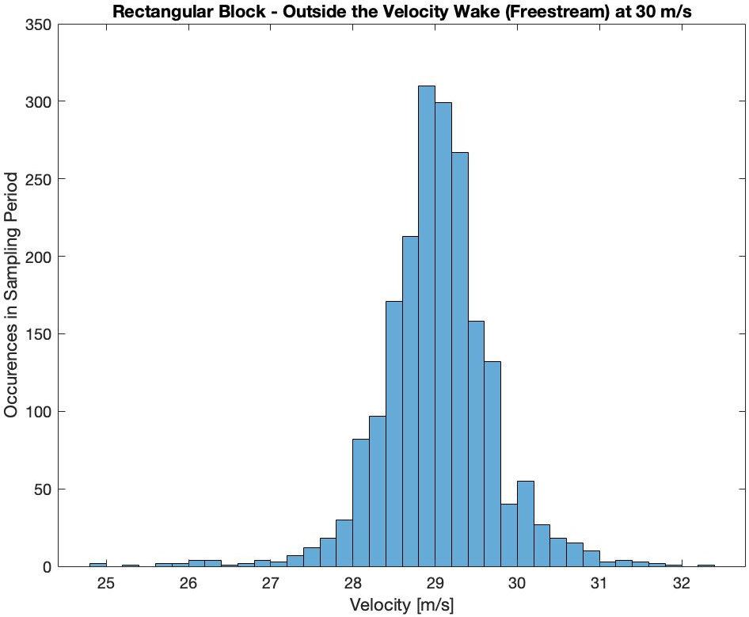
Visual Results – Rectangular Block (Freestream)

Slide 9
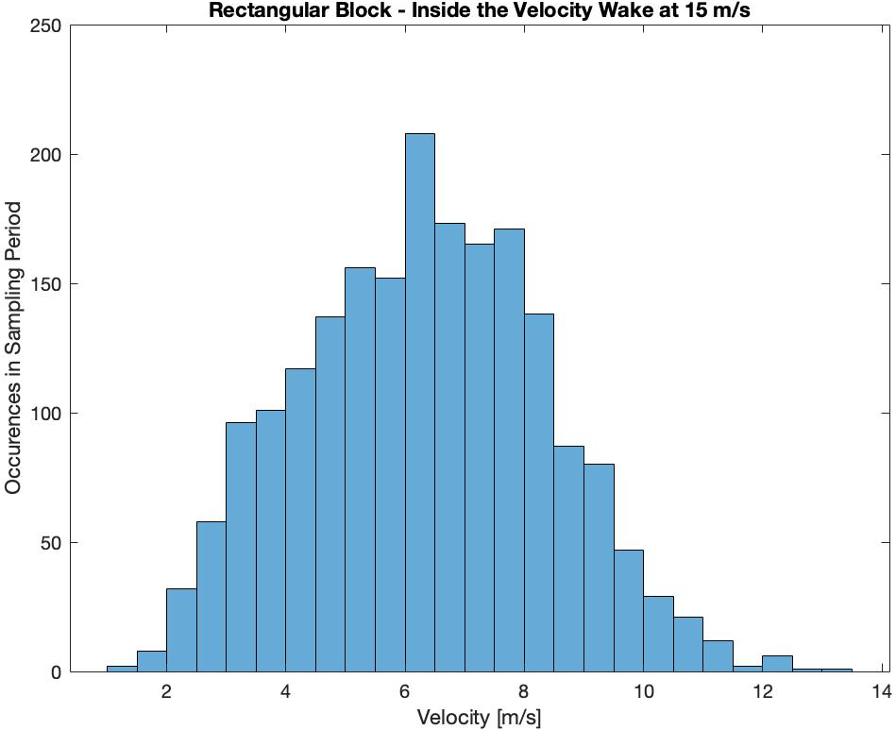
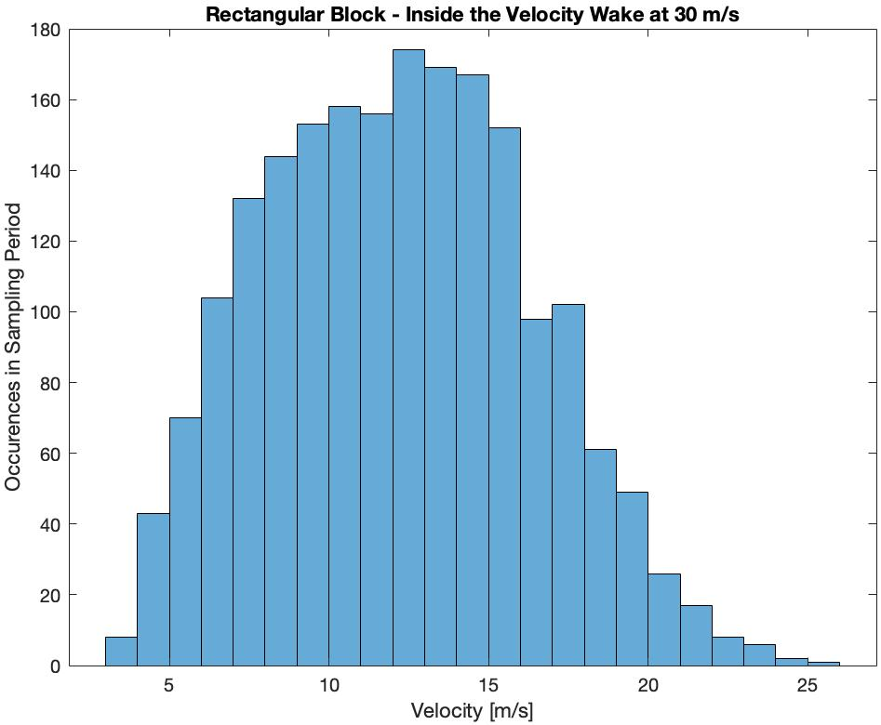
Visual Results – Rectangular Block (Inside the Wake)

Slide 10
Numerical Results – Steady Loads
Cylindrical Rod Steady Load Results:
Freestream Velocity = 15 m/s
  Freestream Dynamic Pressure = 137.373 Pa
  In-Wake Dynamic Pressure = 81.947 Pa
Freestream Velocity = 30 m/s
  Freestream Dynamic Pressure = 551.211 Pa
  In-Wake Dynamic Pressure = 288.518 Pa
Rectangular Block Steady Load Results:
Freestream Velocity = 15 m/s
  Freestream Dynamic Pressure = 132.802 Pa
  In-Wake Dynamic Pressure = 24.495 Pa
Freestream Velocity = 30 m/s
  Freestream Dynamic Pressure = 516.191 Pa
  In-Wake Dynamic Pressure = 91.359 Pa

Slide 11
Numerical Results – Unsteady Loads
Maximum unsteady loads calculated 3 standard deviations from sample mean (99.7%)
Cylindrical Rod Unsteady Load Results:
Freestream Velocity = 15 m/s
  Freestream Dynamic Pressure = 154.374 Pa
  In-Wake Dynamic Pressure = 275.050 Pa
Freestream Velocity = 30 m/s
  Freestream Dynamic Pressure = 609.444 Pa
  In-Wake Dynamic Pressure = 718.754 Pa
Rectangular Block Unsteady Load Results:
Freestream Velocity = 15 m/s
  Freestream Dynamic Pressure = 161.766 Pa
  In-Wake Dynamic Pressure = 95.532 Pa
Freestream Velocity = 30 m/s
  Freestream Dynamic Pressure = 592.981 Pa
  In-Wake Dynamic Pressure = 369.398 Pa

Slide 12
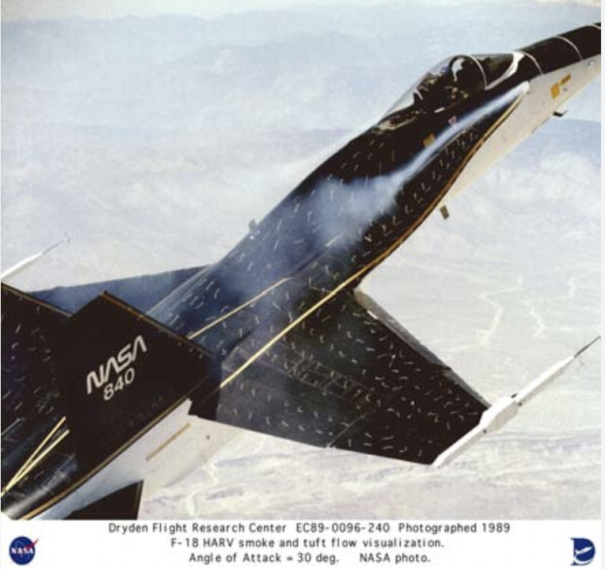
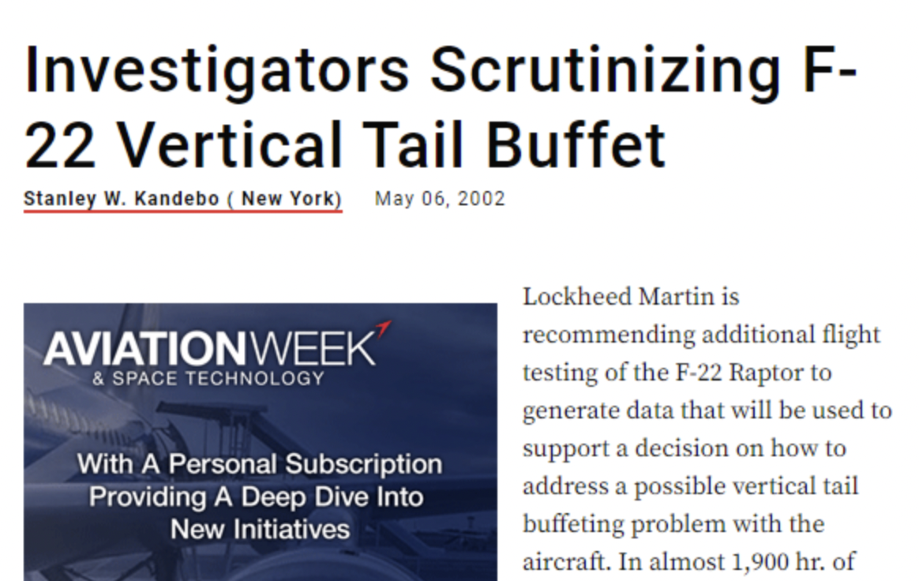
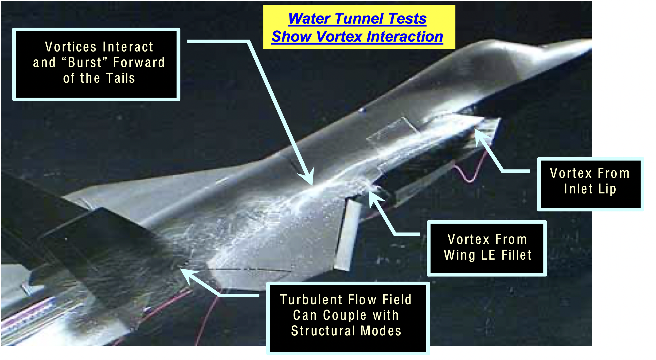
Industry Importance
- Failures occur all the time in industry due to improper maximum load estimations
  Tail buffet in the F18 (1980s)
Tail buffet in the F22 (2000s)
Tail buffet in the JSF (2000s)
Not accounting for maximum loads, causing systems to fail

Slide 13
Acknowledgements
I would like to thank first, the ASU NASA Space Grant Initiative for providing me with the means and the excellent opportunity to carry out this research. Additionally, I would like to thank my mentor, Timothy Takahashi, for not only guiding me through this research, but also providing me with technical insight to the Aerospace industry, making me a viable candidate for all my future endeavors.

Slide 14
Questions?

